Slide 1
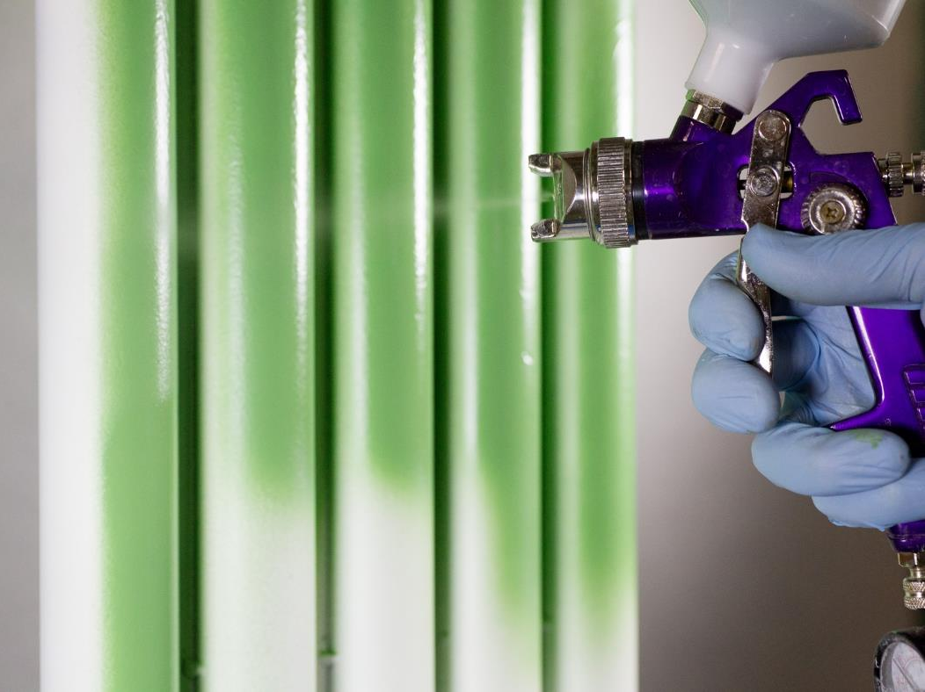
Optecoat™ By Fireside Coatings Sprayed-on Ceramic Protection

Slide 2
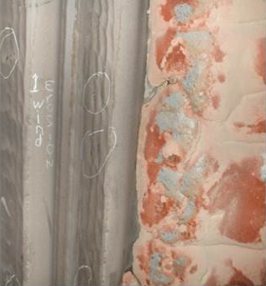
CFB Boiler Tube Wastage
Erosion/Corrosion
Erosion: function of particle density, velocity, shape, size, speed, quantity
High solids in flue gas will cause erosion.
Velocity at cyclone inlet can be as high as (30m/sec).
Particle “angle of attack” also greatly affects the erosion rate

Slide 3
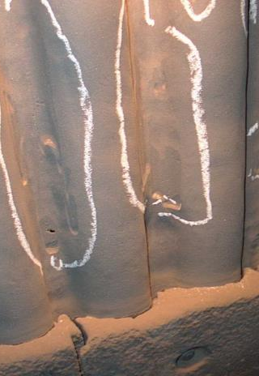
CFB Tube Wastage
Lower Combustor Erosion
Erosion: Also influenced by:
  The flow of solids down the waterwall
  The geometry of the combustor wall.
Solids flow down the furnace wall at a typical velocity of 1-2 m/sec. for small boilers and as much as 6-7 m/sec. for very large boilers.

Slide 4
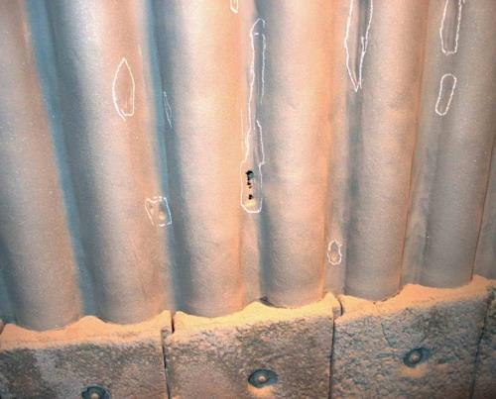
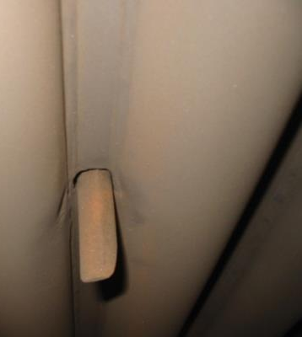
CFB Tube Wastage
Lower Combustor Erosion
Abrupt changes in the downward solids flow cause erosion.
These changes can be caused by the waterwall /refractory interface, protruding instrumentation or irregularities and weld defects in membranes and tube welds.

Slide 5
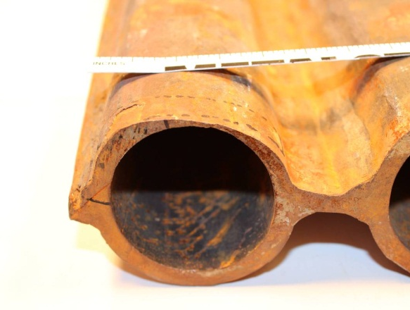
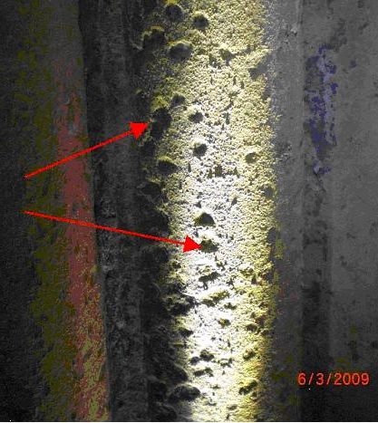
CFB Tube Wastage
Corrosion
Can be caused from fuels that create corrosive gases such as chlorine and sulfur .
Induced corrosion deposits containing molten salts, etc.
Dew point corrosion.

Slide 6
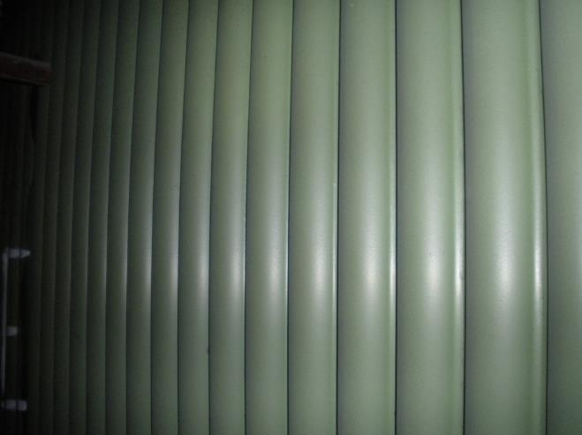
Maintenance Options
Tube replacement
Weld overlay (laser, GMAW, Spray Fuse)
Tube repairs
Design changes
Thermal spray
Thermal spray
Ceramics

Slide 7

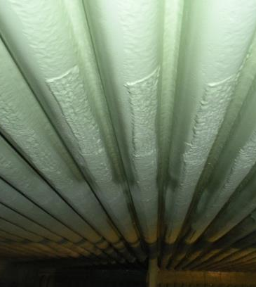
Fireside Coatings Optecoat™
Sprayed-on Ceramic Coating
Erosion/corrosion resistant ceramic
High temperature resistance
Fast application rates
Visual inspection aid
Cost effective

Slide 8


What is Optecoat™?
Spray-on (dual-color) ceramic coating
Verifiable and cost effective maintenance option
Optecoat will extend tube life and improve equipment performance and reliability.
The Optecoat technology was designed based on over 40 years of practical “on site” experience both in the US and internationally.

Slide 9
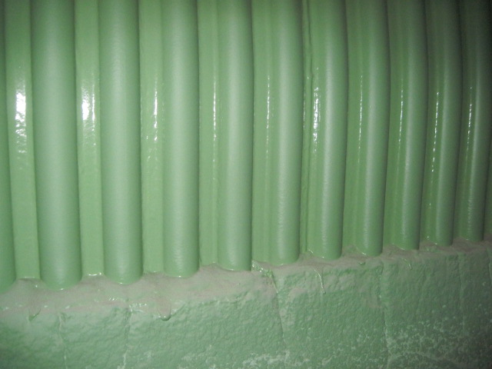
Optecoat™ Ceramic Protection
For CFB boilers

Slide 10
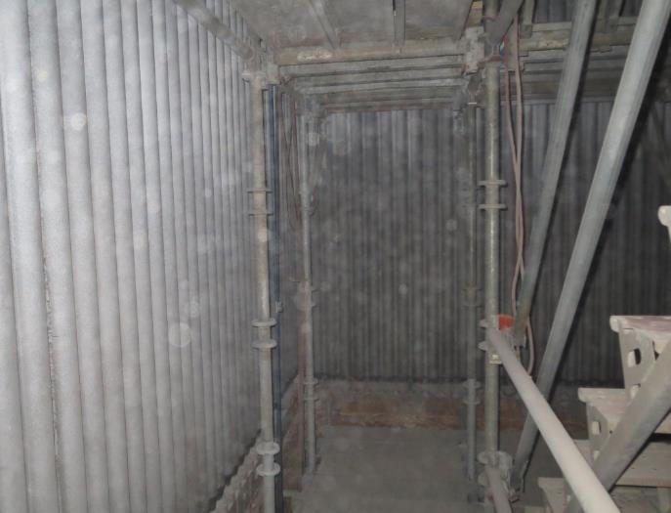
Case History- AG Processing (AGP)
Hastings, Nebraska
B&W design in operation since 2009.
Design fuel – powder river basin coal (PRB)
Steam Flow – 311,000 lb./h
Steam pressure – 150 psig
Steam temp. 440°F
Issue tube erosion causing
periodic tube failures.

Slide 11
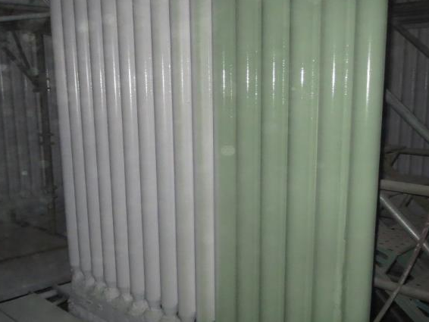
AG Processing
Hastings, Nebraska
Application 2014– 420+ square meters sprayed on ceramic coating
Product- Fireside OpteCoat™ erosion resistant duel color application
200 micron thick base coat 200 micron thick top coat (16 mils)

Slide 12
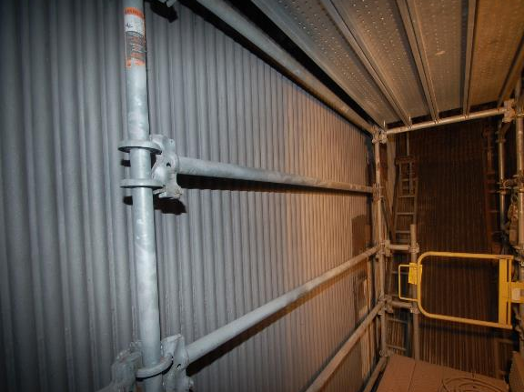
AG Processing
Hastings, Nebraska
Water walls were inspected and all tube repairs were completed.
Tube walls were abrasive blasted with 20/40 garnet to achieve a NACE 1 white blast condition and a 75µ surface profile.
Surface profile was completed in 24 hours. (2-12 hour shifts) using three blast machines.

Slide 13
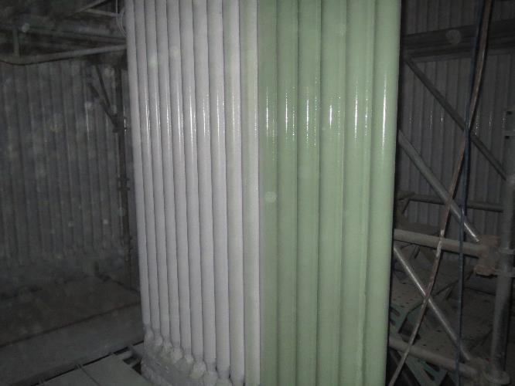
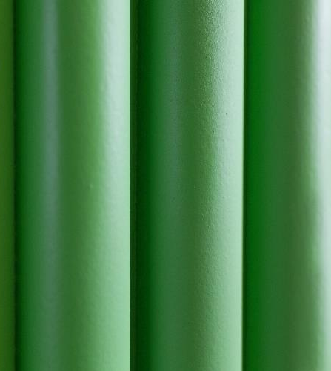
AG Processing
Hastings, Nebraska
The Optecoat™ ceramic coating was applied to the water wall tubes including at the refractory/ tube wall interface.
Ceramic coating was also applied to the hanging pendants in the upper furnace.
The ceramic application was completed in 23 hours utilizing 2 Airless spray systems.

Slide 14
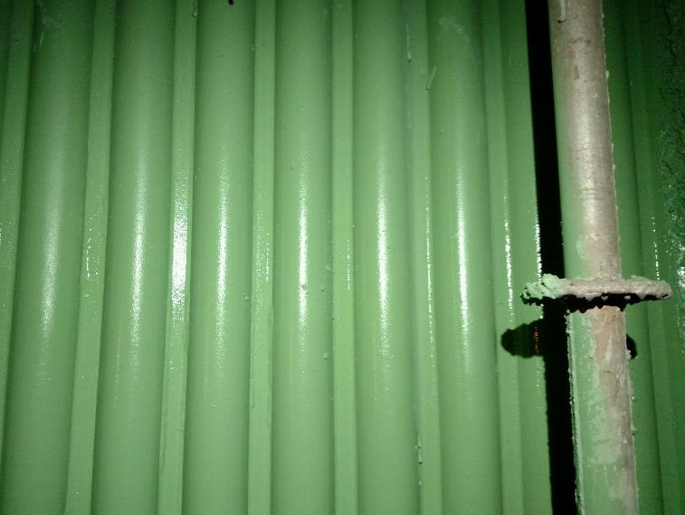
AG Processing
Hastings, Nebraska
After Optecoat™ completion, the coating was allowed to dry at an ambient temperature of between 12.2º -16.7ºC for 28 hours before normal boiler start up procedures were followed.

Slide 15
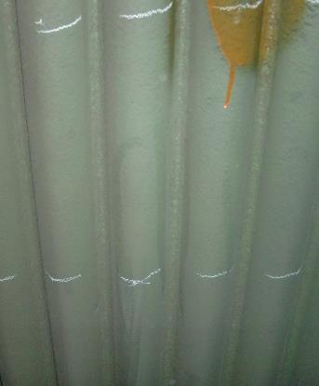
AG Processing
Hastings, Nebraska
After the Optecoat™ application the boiler experienced no new tube leaks and no down time due to tube failures.
During the next scheduled inspection the Optecoat™ was in good condition showing minimal coating loss. Consequently additional areas were coated based on the coatings exceptional performance.

Slide 16
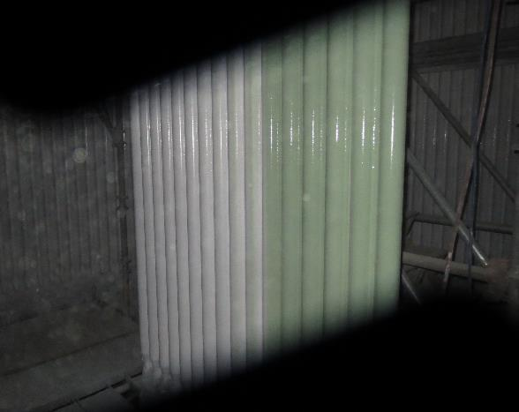
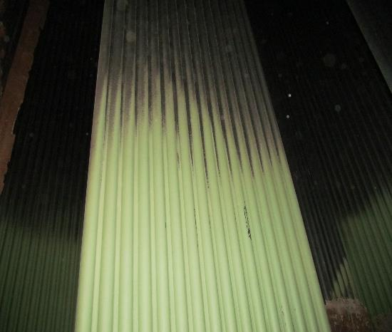
AG Processing
Hastings, Nebraska
Since the original Optecoat™ application over 3 years ago, other tube areas have been ceramic coated in the boiler. Areas of corrosion in the precipitator have also been coated.
> Original Optecoat as applied > Condition after I year run

Slide 17
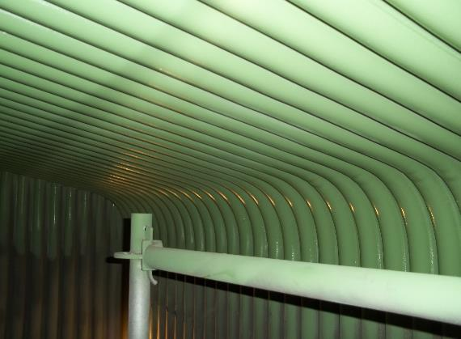
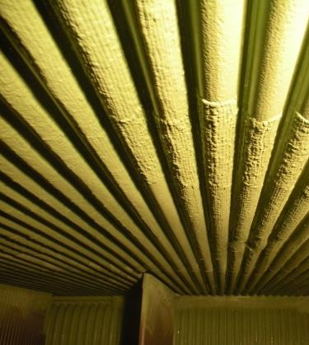
CONCLUSIONS
Fireside ceramic coatings are currently being used in CFB boilers to reduce erosion and corrosion of fireside boiler tubes.
Use of Optecoat™ can be a cost effective maintenance option for CFB boilers.

Slide 18

Contact us…..
Bexxon Global Pte Ltd
50 Ubi Crescent, #01-08 Ubi Techpark
Singapore,
O: +65 62520237 www.bexxonglobal.com info@bexxonglobal.com
Fireside Coatings
Jacksonville, Florida 32244
USA

